Slide 1
Using Transformers in Image Classification
Zainab Mohammad
Rajit Puzhakkarezhath
Aviral Mehrotra
Nicholas Chiu

Slide 2
Introduction
Transformers were introduced in 2017 and have become widely used in NLP applications
In 2021, vision transformers were adapted for computer vision applications
“AN IMAGE IS WORTH 16X16 WORDS: TRANSFORMERS FOR IMAGE RECOGNITION AT SCALE” http://arxiv-export-lb.library.cornell.edu/pdf/2010.11929
Vision transformers (ViT) are scalable and outperform while still being relatively cheap to fine-tune

Slide 3
Problem
Motivation: Image classification now typically uses a CNN, so what is the best moving forward?
Goal: Build and train our own vision transformer model and compare it to CNN models (our own and ResNet50)
Will our results show similarities with the original paper? What does this say about the performance and approach of using transformers in the domain of computer vision?

Slide 4



Dataset
EuroSAT
27,000 labelled 64x64 satellite images
Classified into 10 different land use classes (e.g. highway, forest, river, etc)
Using real map data as opposed to simpler images better reflects the viability of using transformers in image classification.
Annual Crop
Forest
Herbaceous Vegetation

Slide 5
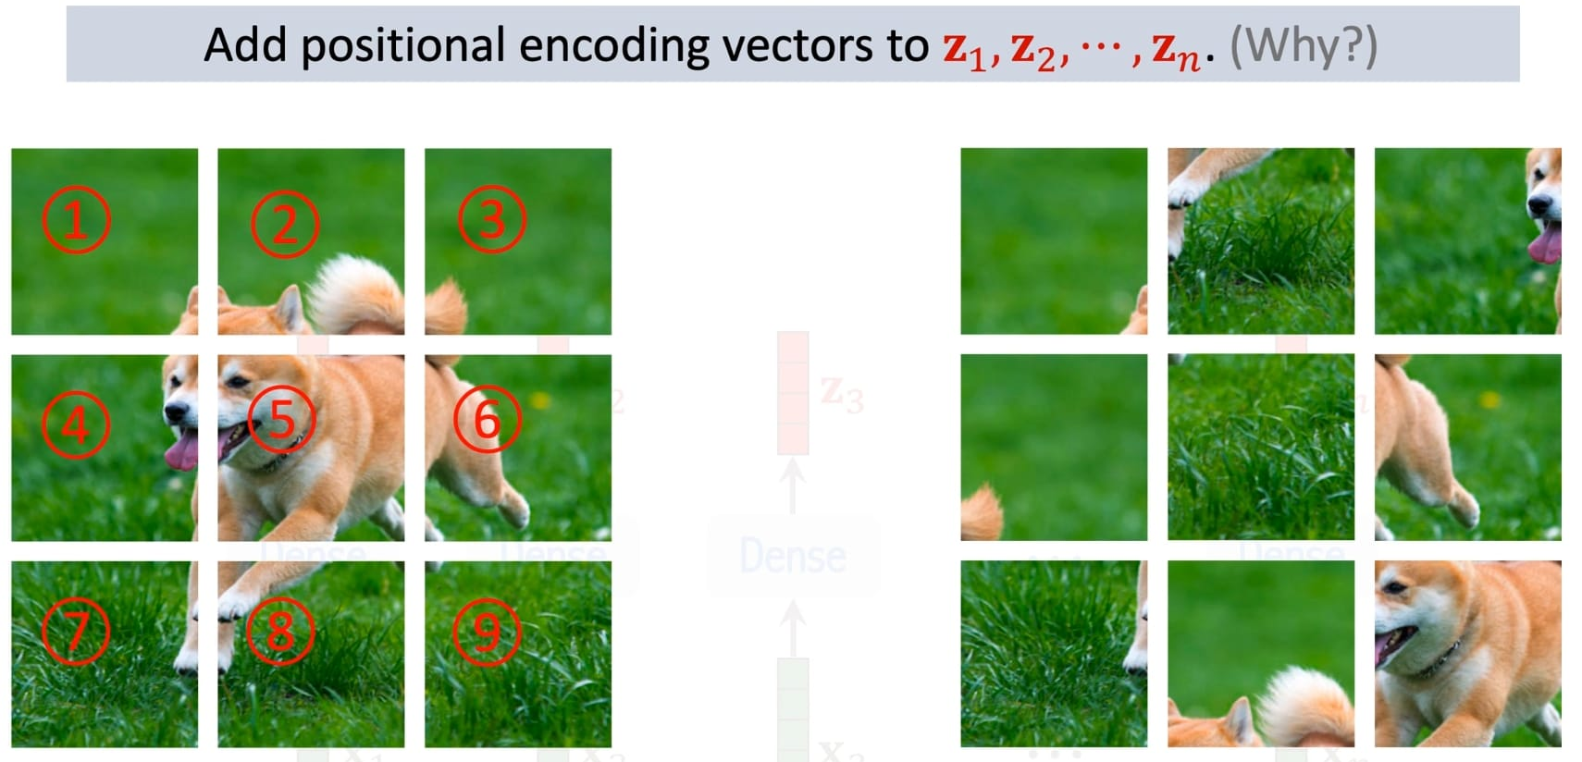
Approach
First, we convert the images to pixel values.
We then perform data augmentation and we take image patches and convert them to 1D sequences.
Positional embeddings are added to these sequences.

Slide 6
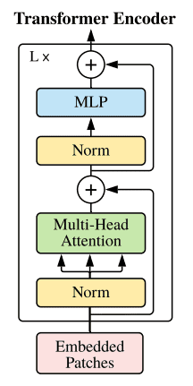
Vision Transformer

Slide 7

CNN Model
5-layer CNN as baseline to compare
3x3 kernel
ReLU activation
MaxPooling
Dropout of 10% to prevent overfitting

Slide 8
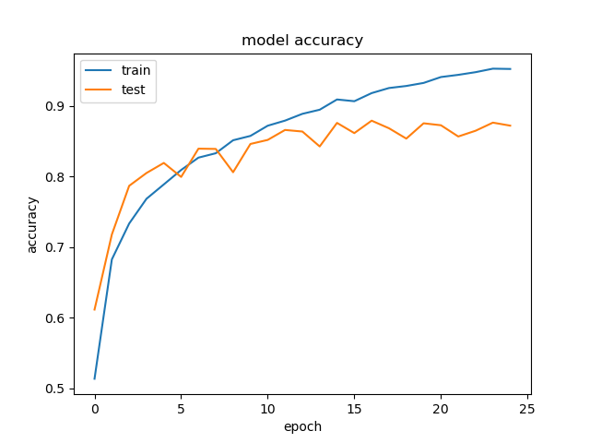
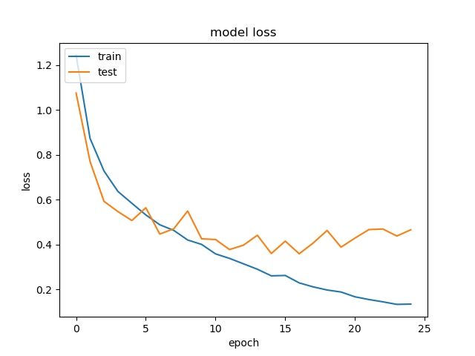
CNN Results

Slide 9
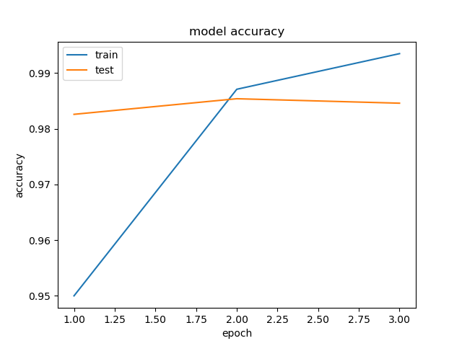
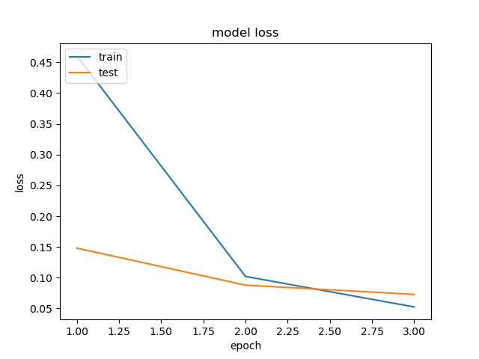
Vision Transformer Results

Slide 10
Evaluation
 | Our CNN (25 epochs) | ResNet50 (25 epochs) | Vision Transformer (3 epochs)
Trainable Parameters | 157,018 | 17,132,490 | 85,806,346
Time per Epoch | 8-9s | 22-23s | >=5000s (83 mins)
Validation Accuracy | 87.20% | 94.69% | 98.46%
Validation Loss | 0.4658 | 0.2988 | 0.0728

Slide 11
Lessons Learned
The fundamental approach was to create an image classification problem by using image patches as tokens in a sequence, and then processing it with a transformer.
Need to be trained on large amounts of data
ViT requires huge amounts of computational resources and time when training from scratch
Has the potential to beat other state-of-the-art CNN architectures with a more powerful machine and pretrained data

Slide 12
Future Work
Current trends are suggesting a shift to the transformer architecture.
A study in June 2021 added a transformer backend to ResNet which reduced costs and increased accuracy.
Tesla is now also using transformers in its autopilot system.
Future computer vision could move towards transformers instead of CNNs

Slide 13
Thank You!
Questions?

